Slide 1
Chapter 3 :
Display Device and Interfacing
Visit for more Learning Resources

Slide 2
LCD (Liquid Crystal Display) Monitor :
Thin, flat display
Each pixel of an LCD typically consists of a layer of molecules aligned between two transparent electrodes, and two polarizing filter
No liquid crystal between polarizing filter , light passing through the 1st filter would be blocked by 2nd polarizer.
The surfaces of the electrodes that are in contact with the liquid crystal material
LCD monitor have a sandwich like structure

Slide 3
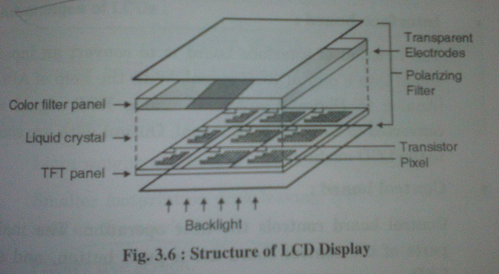

Slide 4
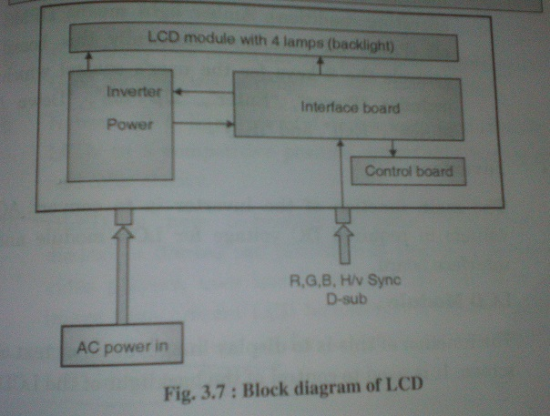
Functional Block Diagram and Working Principal of LCD Monitor :

Slide 5
Interface board :
Convert an input signal into a Digital RGB signal with help of ADC(analog to digital converter)
2. Control board :
Control the user operation
Main parts : Push button, and an LED
Push button :
Pressing it for “ON” to do the Auto adjustment function, releasing it for “OFF” to do nothing
LED :
control the 6 keys for the user’s control which include “Power”, “Enter”, “Up/Plus”, “Down/Minus”, “Exit” and “iKey”.
3. Inverter :
convert AC voltage in required DC voltage for LCD module and interface board

Slide 6
4. LCD Module :
To display image, data or text on screen
To control of the backlight of the LCD

Slide 7
Important Characteristics of LCD :
1. Resolution : Horizontal and vertical size expressed in pixels.
2. Refresh rate : It is the rate at which the electronics in the monitor address the brightness of pixels on the screen
3. Response time : The minimum time necessary to change a pixels color or brightness
4. Dot Pitch : The distance between the centers of two adjacent pixels
5 . Viewable size : The size of an LCD panel measured on the diagonal
6. Matrix type : Passive or active
7. Color support : Many types
8. Brightness : amount of light emitted from the display
9. Contrast ratio : The ratio of the intensity of the brightest bright to the darkest dark.
10. Aspect ratio : The ratio of the width to the height.
11. Input ports : DVI,VGA,LVDS, or even S-Video and HDMI

Slide 8
LCD Types :
LCD display uses two types of matrix :
1. Passive Matrix
2. Active Matrix

Slide 9
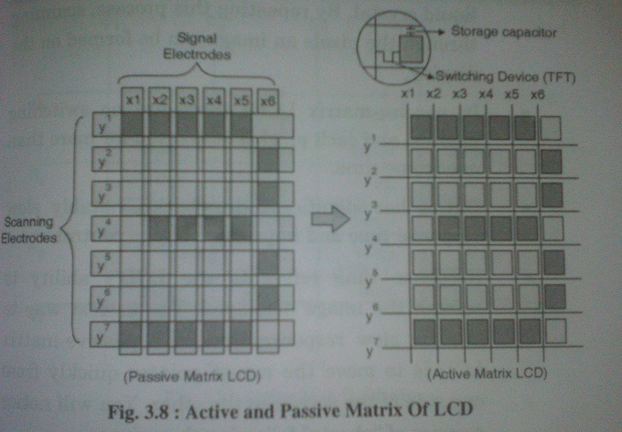

Slide 10
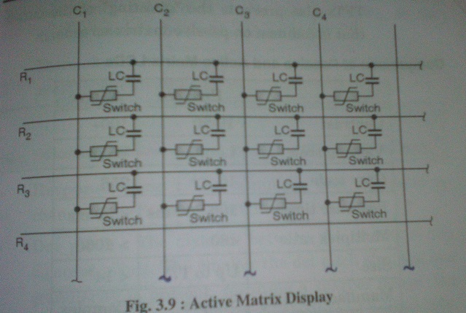

Slide 11
Touch Screen Display :
Is an Electronic Visual display
Component of touch screen :
Touch sensor – detect the location
Controller – interface between the sensor and the display
- take info from touch screen & translates it into info a computer /processor can understand
Software driver – control communication
Touch Screen Technologies :
Resistive
Capacitive
Surface Acoustic Wave
Infrared

Slide 12
Construction and Working of Resistive Touch Screen Technology :
Made up of Polyethylene (PET) and rigid bottom layer made of glass.
Both layer coated with a conducting component called Indium Tin Oxide (ITO)
When touch is made, the flexible screen press down and touches the bottom layer.
A change in electrical current is hence detected and coordinates of the point of touch are calculated by the controller and parsed into readable signals for the operating system to react accordingly.

Slide 13
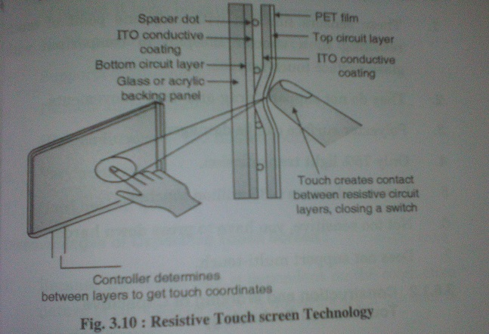

Slide 14
Construction and Working of Resistive Touch Screen Technology :
It consist glass panel coated with a capacitive(conducting) component called Indium Tin Oxide (ITO)
Identified using sensor to sense minor changes in electrical current generated by contact with a finger or changes in electrostatic capacity
Construction and Working of Surface Capacitive Touch panel:
Transparent electrode film is placed at a top of the glass substrate, covered by a protective cover
Electric voltage is applied to electrodes positioned in four corner of glass subtract , generating a uniform low voltage electrical field across the entire panel
Difficult to detect contact at 2 or more points at the same time

Slide 15
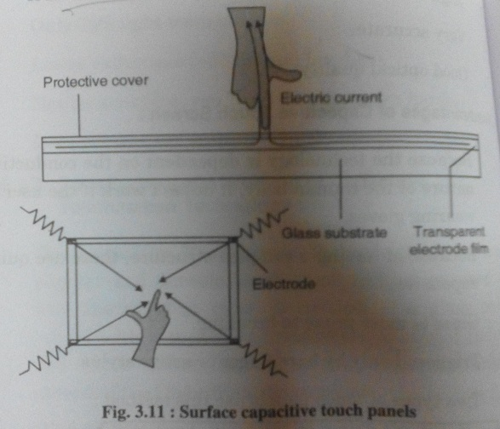
Construction and Working of Surface Capacitive Touch panel:

Slide 16
Construction and Working of Projected Capacitive Touch panel:
Achieve multiple touch technology
Consist of a substrate incorporating an IC chip for processing computations, over which is a layer of numerous transparent electrodes is positioned
Large number of electrodes enables accurate detection of contact at multiple points

Slide 17
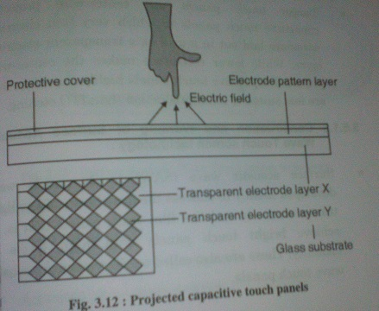

Slide 18
Construction and Working of Surface Acoustic Wave Touch Screen Technology :
Address the drawbacks of low light transmittance in resistive film touch panels that is , to achieve bright touch panels with high levels of visibility
Contain two transducers (transmitting and receiving) placed along the X-axis and Y-axis of monitors glass plate along with reflectors
The waves propagate across the glass and are reflected back to the sensor

Slide 19
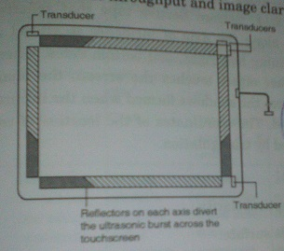

Slide 20
Infrared / Optical Imaging Touch Panels :
Based on infrared image sensor to sense position through triangulation
One infrared LED each at left and right ends of the top of the panel, along with an image sensor
Image sensor captures the shadows formed when the infrared light is blocked

Slide 21
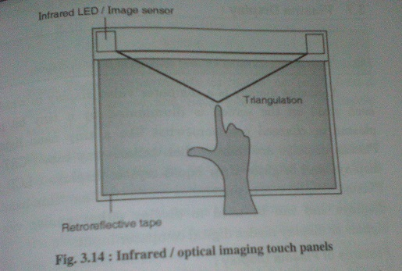

Slide 22
Plasma Display :
Thinner than CRT and Brighter than LCD
Million of tiny cells in compartmented space between two panels of glass
These compartments, bulbs or cells, hold a mixture of xenon and neon gases
Voltage is applied across the cell, the gas in the cells form plasma
Depending on phosphors used, different color of visible light can be achieved
Electrodes are covered by an insulating protective layer

Slide 23
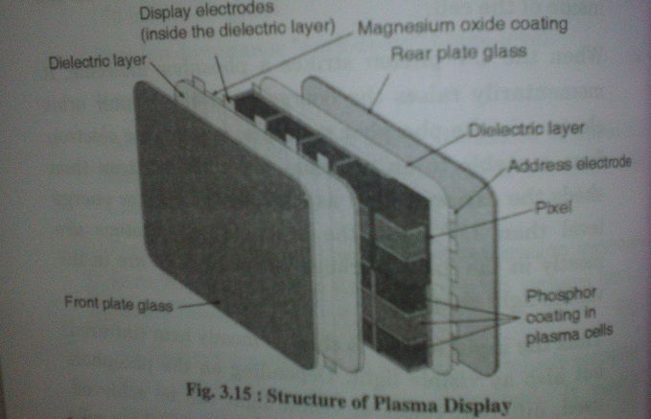

Slide 24
Video Accelerator Card :
It contain own processor to boost performance
Handle the graphics computation
To generate output images to a display
Other characteristics that differentiate graphical accelerators are :
Memory- storing graphical representations
-use DRAM, Video RAM
Bus
Register width – the wider the register, the more data the processor can manipulate with each instruction
Graphical Processing Unit(GPU) - which process images based on the encoding being used
Video Memory – store images processed by the GPU before they are displayed by the monitor
RAMDAC(Random Access Memory Digital-analog Converter) is used for converting digital images stored in the frame buffer as analog to send to the monitor

Slide 25
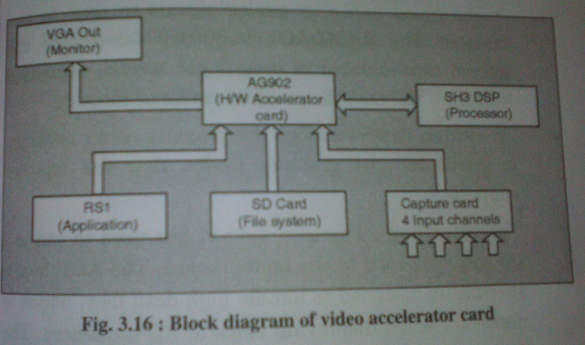
Video BIOS – contains the graphics cards setting
Interface – used to connect the graphics card to the motherboard
For more detail contact us

